Slide 1
MATH221
Mathematics for Computer Science
Unit 2
Predicate Logic

Slide 2
OBJECTIVES
Understand what is a predicate.
Understand what are universal and existential quantifiers.
Understand the use of universal and existential quantifiers to write statements.
Apply the knowledge of universal and existential quantifiers to find the negation of statements that include quantifiers.

Slide 3
Discussion:
In Mathematics we use variables (usually ranging over numbers) in various ways.
How does x differ in what it represents in the following statements?
(i) x² = 0
(ii) x > 2
(iii) x + 0 = x
(iv) x² + 1 = 0

Slide 4
Predicate
A predicate is a sentence that contains one or more variables and becomes a statement when specific values are substituted for the variables.
The domain of a predicate variable consists of all values that may be substituted in place of the variable.
The symbolic analysis of propositions is called propositional calculus and the symbolic analysis of predicates is called predicate calculus.

Slide 5
Predicate: Examples and Notation
“x is a student at Bedford College” and “x is a student at y” are both predicates, where x and y are predicate variables that take values in appropriate sets.
We can use symbols to represent predicates. For example:
We can use P(x) to represent the predicate “x is a student at Bedford College” and Q(x, y) to represent the predicate “x is a student at y”
where x and y are predicate variables that take values in appropriate sets.

Slide 6
Quantifiers
∀x read “for all x” or “for each x
∃x read “there exists an x” or “for some x
∀ is called the Universal quantifier.
∃ is called the Existential quantifier.
Notes:
It is best to avoid the word “any” since it is often ambiguous as to whether it means “every” or “some.”
For ∃x quantifier or there exist quantifier, we need to find what is the x that will satisfy the statement.
For ∀x quantifer or for all quantifier, the y is given and must satisfy all y.

Slide 7
Universal And Existential Statements
Let Q(x) be a predicate and D be the domain of x.
A universal statement is a statement of the form “∀x ∈ D, Q(x)”.
A existential statement is a statement of the form “∃x ∈ D, Q(x)”.
Note that x is the predicate variable.

Slide 8
Discussion:
Returning to the statements in the Discussion, we can use the quantifier notation to restate them clearly:
(i) x² = 0
∃x ∈ ℝ, x² = 0
(ii) x > 2
∃x ∈ ℝ, x > 2
(iii) x + 0 = x
∀x ∈ ℝ, x + 0 = x
(iv) x² + 1 = 0
∀x ∈ ℝ, ~ (x² + 1 = 0)
Note:
1. The symbol ∈ means “belongs to”.
2. The domain of all predicate variables in the above statements is ℝ.

Slide 9
Examples:
1. Write each of the following statements using the universal quantifier.
(i) All dogs are animals.
∀ dog x, x is an animal.
(ii) The square of any real number is positive or zero.
∀x ∈ ℝ, x² ≥ 0.

Slide 10
Examples:
2. Write each of the following statements using the existential quantifier.
(i) There exists a real number whose square is negative.
∃x ∈ ℝ, x² < 0.
(ii) Some dogs are vegetarians.
∃ dog x, x is vegetarian.

Slide 11
Universal Statements: Important
A universal statement is defined to be true if and only if Q(x) is true for every x in D.
A universal statement is defined to be false if and only if Q(x) is false for at least one x in D.
A value of x for which Q(x) is false is called a counterexample to the universal statement.

Slide 12
Existential Statements: Important
An existential statement is defined to be true if and only if Q(x) is true for at least one x in D.
An existential statement is defined to be false if and only if Q(x) is false for every x in D.

Slide 13
Truth Set of a Predicate
The truth set of a predicate is the set of elements in the domain that make the predicate a true statement.
Now try if you can determine whether the universal and existential statements in the previous discussion and examples are true or false.

Slide 14
Aside
Real numbers are further classified as natural numbers, integers, rational numbers, irrational numbers. These sets of numbers are often used as the domain of the variable. The “standard” notation for these categories of numbers are as follows:
1. ℕ represents the set of all natural numbers, or positive whole numbers.
ℕ = {1, 2, 3, 4, …}.
2. ℤ represents the set of all integers or whole number (positive, negative and zero).
ℤ = {…, -2, -1, 0, 1, 2, …}

Slide 15
Aside
3. ℚ represents the set of all rational number. A rational number is one that can be written as a fraction.
Examples: 2 = 2/1; 0.3 = 0.333…= 1/3
An irrational number is one that cannot be written as a fraction, usually has a non-repeating, infinite decimal expansion.
Examples: π; e
4. ℝ represents the set of all real number.
Note that ℝ is formed by ℚ and the set of irrational numbers.
.

Slide 16
Examples:
1. Write the following statements using quantifiers. Determine whether each statement is true or false.
(i) Every integer is a rational number.
∀x ∈ ℤ, x ∈ ℚ.
True
(ii) Some real number is rational.
∃x ∈ ℝ, x ∈ ℚ.
True

Slide 17
Examples:
1. (iii) No real numbers have squares equal to -1.
∀x ∈ ℝ, ~ (x² = -1).
True
Notes:
Distinguish this from not all real numbers have squares equal to -1.

Slide 18
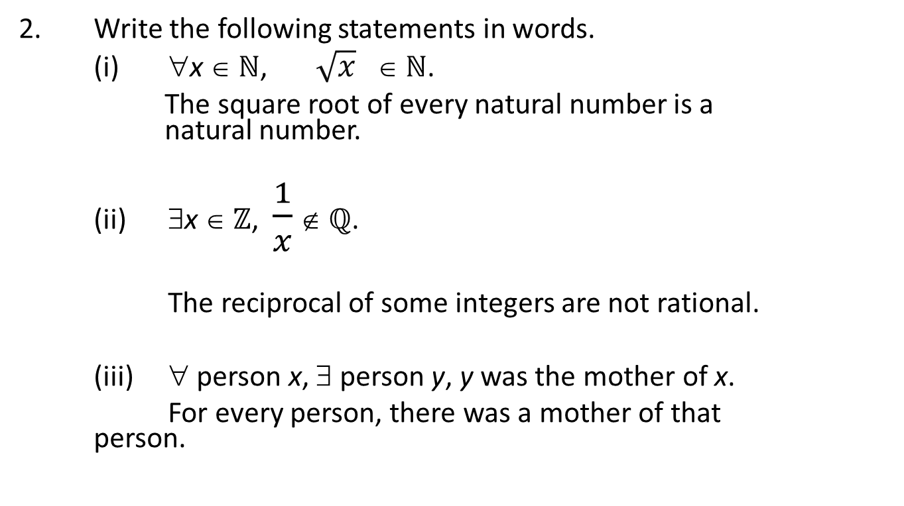
Examples:
2. Write the following statements in words.
(i) ∀x ∈ ℕ, $\sqrt{x}$ ∈ ℕ.
The square root of every natural number is a natural number.
(ii) ∃x ∈ ℤ, $\frac{1}{x}$ ∉ ℚ.
The reciprocal of some integers are not rational.
(iii) ∀ person x, ∃ person y, y was the mother of x.
For every person, there was a mother of that person.

Slide 19
Quantified Statements: Examples
1. Every student likes at least one mathematics subject.
∀ student S, ∃ mathematics subject y, S likes y.
2. All persons are equal.
∀ person a, ∀ person b, a is equal to b.
3. Not all natural numbers are even.
~ (∀n ∈ ℕ, n is even)

Slide 20
Discussion:
What is the definition of an even number?
An integer n is even if, and only if, n equals twice some integer.
Symbolically, if n is an integer, then
n is even ⇔ ∃p ∈ ℤ, n = 2p.
Hence, the sentence “Not all natural numbers are even.” can be expressed in one of the following two ways symbolically:
~ (∀n ∈ ℕ, n is even)
~ (∀n ∈ ℕ, ∃p ∈ ℕ, n = 2p)

Slide 21
Equivalent Forms of Universal Statements
A statement of the form
∀x ∈ U, if P(x) then Q(x)
can be rewritten in the form
∀x ∈ D, Q(x).
Note: D ⊆ U and D is the truth set of P(x).

Slide 22
Equivalent Forms of Universal Statements: Example
A statement of the form
∀x ∈ ℝ, if x ∈ ℤ then x ∈ ℚ.
can be rewritten in the form
∀x ∈ ℤ, x ∈ ℚ. (Note: ℤ ⊆ ℝ)

Slide 23
Examples:
Express the following laws of arithmetic using quantifiers.
(i) Commutative law for +:
If x and y are real numbers, then x + y = y + x.
∀x ∈ ℝ, ∀y ∈ ℝ, x + y = y + x.
(ii) Distributive law for × over +:
If x, y and z are real numbers, then x(y + z) = xy + xz.
∀x ∈ ℝ, ∀y ∈ ℝ, ∀z ∈ ℝ, x(y + z) = xy + xz.

Slide 24
Quantifications Of Two Variables
Statement When True? When False?
∀x ∀y P(x, y) P(x, y) is true for There is a pair x, y
∀y ∀x P(x, y) every pair x, y. for which P(x, y) is false.
∀x ∃y P(x, y) For every x there There is an x such that
is a y for which P(x, y) is false for every y.
P(x, y) is true.

Slide 25
Quantifications of Two Variables
Statement When True? When False?
∃x ∀y P(x, y) There is an x for For every x there is a y
which P(x, y) is for which P(x, y) is false.
true for every y.
∃x ∃y P(x, y) There is a pair P(x, y) is false for every
∃y ∃x P(x, y) x, y for which pair x, y.
P(x, y) is true.

Slide 26
Discussion:
Consider the following statements.
∀x ∈ ℝ, ∃y ∈ ℝ, x + y = 0. (1)
∃y ∈ ℝ, ∀x ∈ ℝ, x + y = 0. (2)
(i) Are the statements the same?
No.
(ii) Determine whether each statement is true or false?
(1) is true.
(2) is false.
(iii) Is the order in which ∀ and ∃ appear important?
Yes.

Slide 27
Negations Of Universal Statements
The negation of a statement of the form
∀x ∈ D, Q(x)
is logically equivalent to a statement of the form
∃x ∈ D, ~ Q(x).
Symbolically,
~ (∀x ∈ D, Q(x)) ≡ ∃x ∈ D, ~ Q(x).

Slide 28
Negations Of Existential Statements
The negation of a statement of the form
∃x ∈ D, Q(x)
is logically equivalent to a statement of the form
∀x ∈ D, ~ Q(x).
Symbolically,
~ (∃x ∈ D, Q(x)) ≡ ∀ x ∈ D, ~ Q(x).

Slide 29
Negations Of Universal and Existential Statements: Example
Write formal negations for the following statements:
a. ∀ primes p, p is odd.
~ (∀ primes p, p is odd)
≡ ∃ a prime p, p is not odd.
b. ∃ a triangle T, the sum of the angles of T equals 200°.
~ (∃ a triangle T, the sum of the angles of
T equals 200°)
≡ ∀ triangles T, the sum of the angles of T does not equals 200°.

Slide 30
Negations Of Universal Conditional Statements
By definition of the negation of a for all statement,
~ (∀x ∈ U, P(x) ⇒ Q(x)) ≡ ∃x ∈ U, ~ (P(x) ⇒ Q(x)).
But negation of an if-then statement is logically equivalent to an and statement. More precisely,
~ (P(x) ⇒ Q(x)) ≡ ~ (~ P(x) ∨ Q(x))
≡ P(x) ∧ ~ Q(x).
Therefore,
~ (∀x ∈ U, P(x) ⇒ Q(x)) ≡ ∃x ∈ U, P(x) ∧ ~ Q(x).

Slide 31
Negations Of Quantified Statements (with two Quantifiers)
~ (∀x ∈ D, ∃y ∈ E, P(x, y))
≡ ∃x ∈ D, ∀y ∈ E, ~ P(x, y).
~ (∃x ∈ D, ∀y ∈ E, P(x, y))
≡ ∀x ∈ D, ∃ y ∈ E, ~ P(x, y).

Slide 32
Negations Of Quantified Statements (with two Quantifiers): Example
Write a formal negation for the following statement:
a. For all square x, there is a circle y such that x and y have the same colour.
  ∀ square x, ∃ circle y, x and y have the same colour.
Negation is:
∃ a square x, ∀ circle y, x and y do not have the same colour.

Slide 33
Negations Of Quantified Statements (with two Quantifiers): Example
Write a formal negation for the following statement:
b. There is a triangle x such that for all square y, x is to the right of y.
∃ a triangle x, ∀ square y, x is to the right of y.
Negation is:
∀ triangles x, ∃ a square y, x is not to the right of y.

Slide 34
End of Unit 2

